Slide 1
Proximity-Proof: Secure and Usable Mobile Two-Factor Authentication
Presented by Kyle Ebding and Yuchen Yuan

Slide 2
Background: Two-Factor Authentication (2FA)
There are various ways to verify one’s identity for signing in to a system:
Asking for something only the user should know (i.e. a password)
Asking for something only the user should be (biometric data)
Asking for something only the user should have (a hardware access token, a specific phone, etc.)
The most common scheme is to only ask for a password
Problem: passwords can be insecure
Two-factor authentication requires two different identity verification methods to confirm the user’s identity
Most common form is password + possession

Slide 3
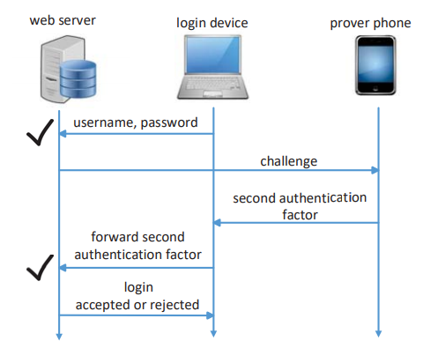
Typical 2FA Interaction
The user sends a login request from a client device
The server sends a “challenge” to the 2FA device, called the “prover”
Can require the user to enter a one-time code, press a button, etc.
2FA device responds to the challenge, either directly to the server or through the client as a proxy
If the challenge is passed, the server grants access to the client device
2FA model used by Proximity-Proof
(image credit to paper authors)

Slide 4
Proximity-Based 2FA
Existing 2FA can be tedious to use
2FA challenge often has the user enter a one-time code or a rolling code from the prover on the login client
Can be difficult for people with visual difficulties or conditions that impair the ability to use their hands
Proximity-Based 2FA tries to create a zero-effort verification by checking if the prover is in close physical proximity to the login client

Slide 5
Proximity-Based 2FA Mechanisms
Bluetooth and WiFi are not optimal
Most browsers do not support a Bluetooth API
WiFi requires the prover and login client to be on the same network
Both WiFi and Bluetooth have fairly long range, which increases vulnerability to co-located attacks (discussed later)
What about using acoustic signals?

Slide 6
Previous Work on Acoustic Proximity-Based 2FA
Sound-Proof¹ checks that the prover and login client detect the same ambient sound
Can be blocked by an adversary drowning out ambient noise
SlickLogin² sends an inaudible acoustic signal from the prover to the login client
Both are vulnerable to man-in-the-middle attacks
https://www.usenix.org/node/190981
https://en.wikipedia.org/wiki/SlickLogin

Slide 7
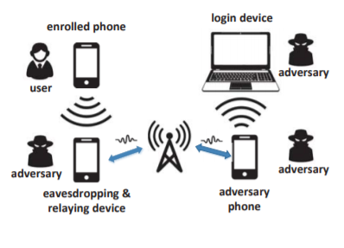
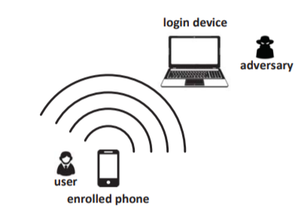
Man-in-the-Middle and Co-located Attacks
Illustration of a man-in-the-middle attack
Illustration of a co-located attack
(image credit to paper authors)

Slide 8
Proximity-Proof Motivation and Design
Goal is to provide zero-effort 2FA
Uses acoustic proximity-based 2FA to achieve this
Needs to be secure against man-in-the-middle attacks and co-located attacks
Relies on fingerprinting the prover’s speakers and the login client’s microphone to verify the device emitting the sound, defending against man-in-the-middle attacks
Measures the distance between the prover and the login client to mitigate co-located attacks

Slide 9
Threat Model
The user’s username and password have been compromised and are known by the attacker
The attacker tries to log in via a web browser on an arbitrary device
Communication between browser and server secured (e.g. TLS)
Communication between enrolled 2FA device and server secured (e.g. TLS)
There exists a line-of-sight channel between the 2FA device and the login device
Notes:
The user has possession of the 2FA device, which is not compromised
The attack is successful if the web server is convinced that theadversary has the enrolled phone associated with the user-name.

Slide 10
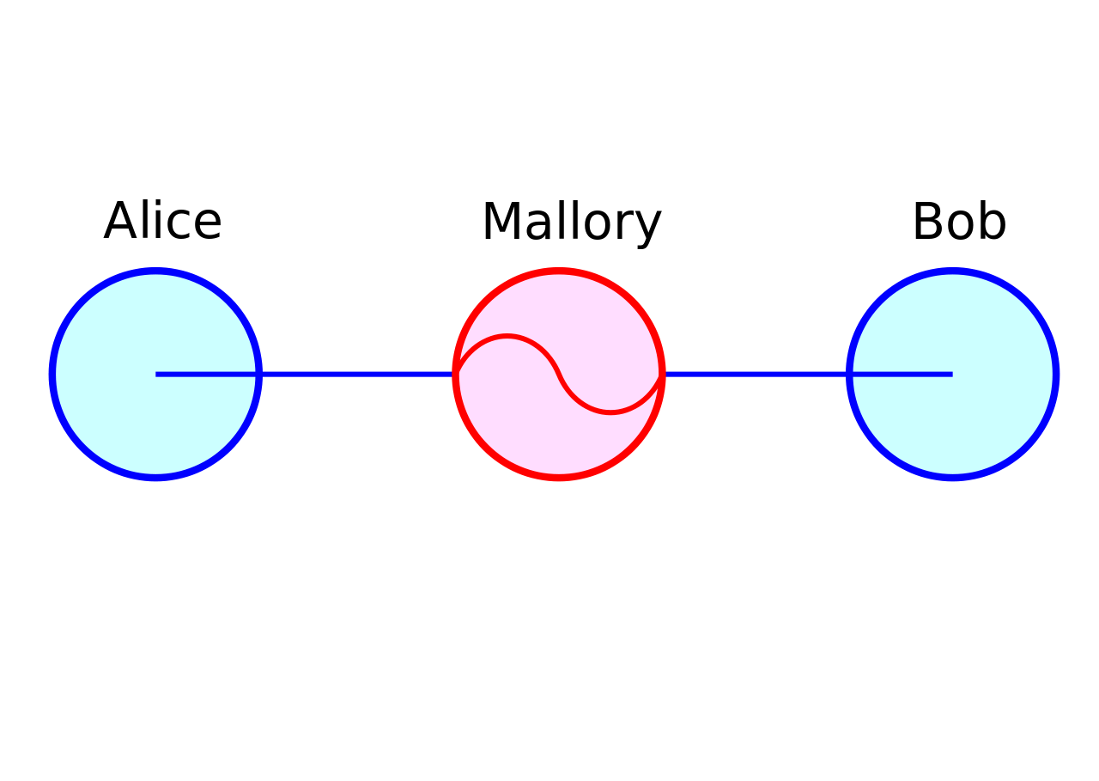
Man-in-the-Middle(MiM) attack
Suppose Alice wishes to communicate with Bob.
Meanwhile, Mallory wishes to intercept the conversation to eavesdrop and optionally to deliver a false message to Bob.
Notes:
e.g. by having an accomplice or hidden eavesdropping device near the victim.

Slide 11
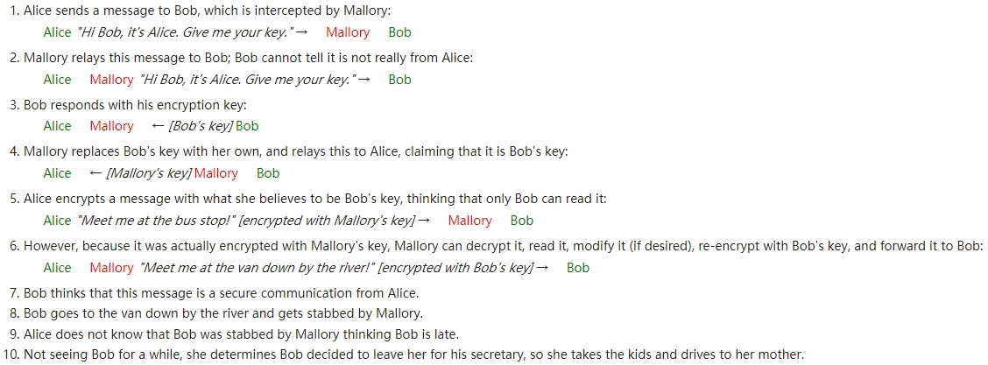

Slide 12
Man-in-the-Middle(MiM) attack
The adversary sets up a high-speed, invisible channel between the enrolled phone and the adversarial login device.
When the adversary attempts to log in,the web server triggers the enrolled phone to generate an automatic 2FA response which is relayed in real time to the login device via the adversarial channel.
Notes:
e.g. by having an accomplice or hidden eavesdropping device near the victim.

Slide 13
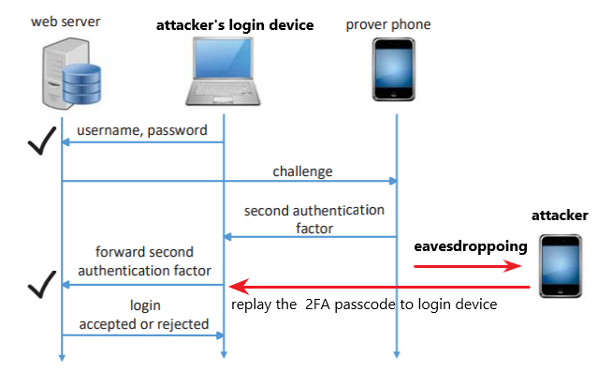

Slide 14
Co-located Attacks
The adversary is physically co-located with the victim such as in a library, a bar or other often crowded public venues.
The adversary’s attempted login again triggers an automatic response from the enrolled phone, which can be directly received by the adversary’s login device.
Notes:
The server considers the enrolled phone near the login device and then admits the adversary by mistake

Slide 15
Resilience to MiM Attacks
Proximity-Proof effectively adds the acoustic fingerprint of an enrolled phone as the third factor of authentication.
Acoustic fingerprint

Slide 16
Resilience to Co-Located Attacks
Proximity-Proof defeats the co-located attack by measuring the distance between the enrolled phone and the login device in the same duration for speaker and microphone fingerprinting.
They expect that the normal distance between the enrolled phone and login device of a legitimate user is upper-bounded by a small range (e.g. 0.5m)

Slide 17
Acoustic Fingerprinting
Prover phone emits acoustic signals at frequencies 18kHz, 18.1kHz, 18.2kHz… 20kHz¹
Both prover phone and login client record received amplitude of the signal for each frequency
Then, login client emits the same signals, which are again recorded by both the prover phone and the login client
Prover phone sends both its sets of measurements to login client
Login client uses the information to create a fingerprint of the prover phone’s speakers and microphone
1. These frequencies have little ambient noise and are inaudible to human ears
Notes:
Login client creates 20-dimensional vectors (one dimension per measurement) S (for speaker) and M (for microphone)
Normalizes the vectors to get scores S-hat and M-hat
The fingerprint is the concatenation of S-hat and M-hat
Process can be repeated, in which case scores are the concatenation of the averages of S-hat and M-hat

Slide 18
Acoustic Fingerprinting
If the Euclidean distance between the collected fingerprint score and the legitimate fingerprint is above the threshold 𝜏=0.4, then the prover phone is rejected as an imposter
0.4 was chosen because experiments showed it to be optimal for precision and recall of the binary classification method
Notes:
Precision is ratio of true positives over all selected elements Recall is ratio of selected positives to all positives

Slide 19
Cross-Device Ranging
To protect against co-located attacks, need to measure distance between prover phone and login client
Each device emits an acoustic signal and listens for the signal from both itself and the other device
By measuring the time between when the signals were initially sent and when the signals were received, the devices can estimate
Notes:
Login device emits up-chirp, prover phone emits down-chirp
High auto-correlation, low cross-correlation allow for easy distinguishing

Slide 20
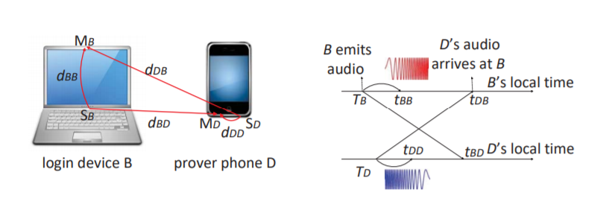
Cross-Device Ranging

Slide 21
Evaluation

Slide 22
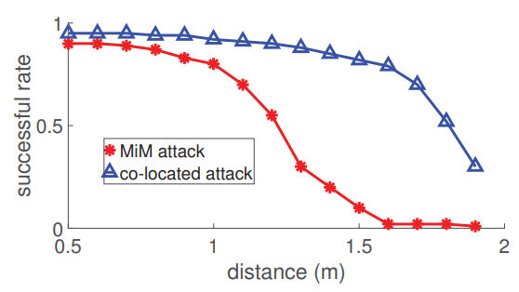
Impact of Attacks on One-Time 2FA
Notes:
For the MiM attack, we placed one monitoring phone near the victim device.The monitoring phone was connected with another phone far away from the victim device through Wi-Fi.
For the co-located attack, we placed the login device close to the victim device. The co-located attack succeeds if the login device correctly extracts the one-time passcode from the audio signal transmitted by the victim device.

Slide 23
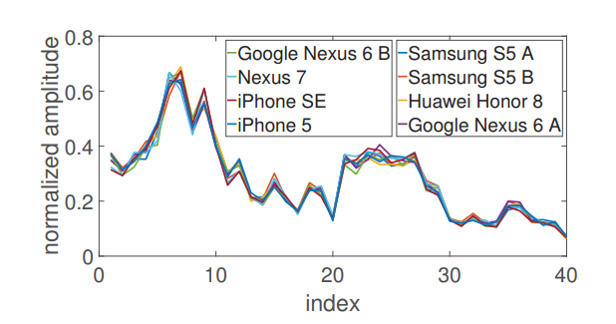
Efficacy of Acoustic Fingerprinting
Acoustic fingerprints of a Samsung Galaxy 5 extracted by different devices.
Notes:
They use 9 mobile devices,
We first chose a Samsung Galaxy 5 as the user’s device and extracted its fingerprint with every other device. The extracted acoustic fingerprints are shown in Fig. 8.
As we can see, the fingerprints of the same device extracted by different devices are very similar.

Slide 24
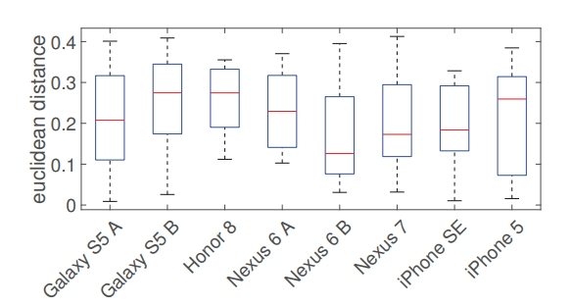
Efficacy of Acoustic Fingerprinting
Notes:
the Euclidean distance between each runtime fingerprint and its corresponding copy stored at the web server.
Only three of the 1,120 runtime fingerprints are more than τ = 0.4 away from the corresponding stored copies.

Slide 25
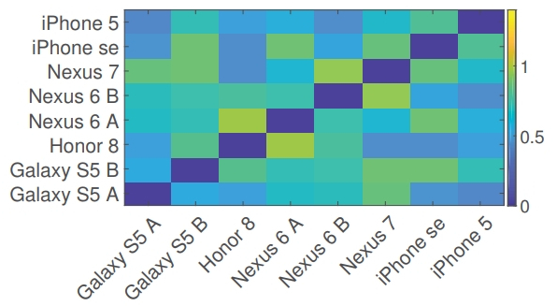
Efficacy of Acoustic Fingerprinting

Slide 26
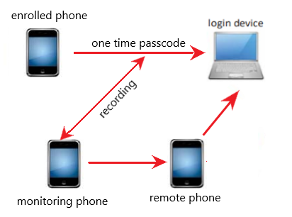
Defeating MiM Attacks
The MiM attack succeeds if the login device correctly extracts the one-time passcode from the audio replayed by the remote phone.
Notes:
The monitoring phone was connected with another phone far away from the victim device through Wi-Fi.
When the victim’s device transmitted a one-time passcode via acoustic channels, the monitoring phone recorded the audio and forwarded it to the remote phone, which then plays the received audio using its speaker.

Slide 27
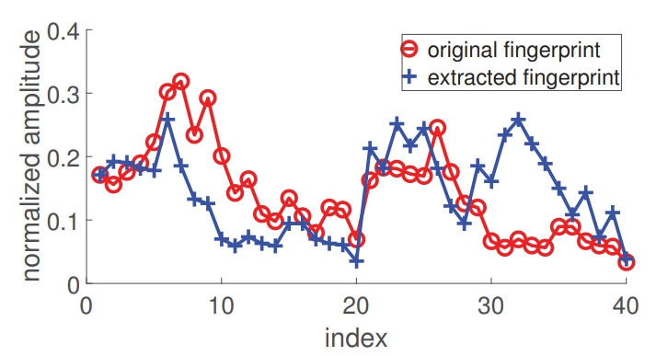
Original fingerprint(stored on server) v.s. Extracted fingerprint(replayed by remote phone)
Notes:
Since the later one is actually the fingerprint of the relaying Nexus 7, we can see the significant difference in Fig. 11, based on which the web server can easily deny the illegitimate login request.

Slide 28
Defeating Co-Located Attacks
Accuracy of Ranging Method- measure the distance between a laptop-phone pair (L&P), a tablet-phone pair (T&P), and a phone-phone pair (P&P) .
Notes:
the ranging accuracy for T&P and P&P is quite high with the average error in both cases below 5cm in all three environments. In contrast, the ranging accuracy for L&P is slightly lower with the average error around 4.2cm, 6.2cm, and 6.3cm in the office, bookstore and coffee house, respectively.
reason is that the laptop’s microphone is at the top of the screen, while its speaker is behind the keyboard. The distance between the laptop’s speaker and microphone is affected by the screen-keyboard angle, which introduced additional errors into the ranging result in comparison with the other two cases.

Slide 29
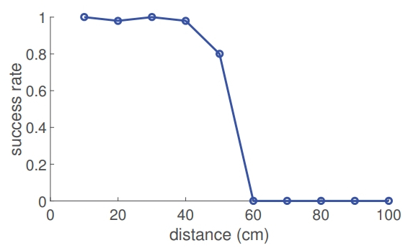
Defeating Co-Located Attacks
The co-located attack succeeds if the login device correctly extracts the one-time passcode from the audio signal transmitted by the victim device
Notes:
when the distance is less than 40cm, the authentication attempt succeeds for at least 98% of the cases
when the distance is 50cm, the successful authentication rate drops to around 80%, which is mainly caused by the ranging error.
Moreover, if an attacker launches the co-located attack from a distance of 60cm or larger from the login device, almost none of his authentication attempts can succeed.

Slide 30
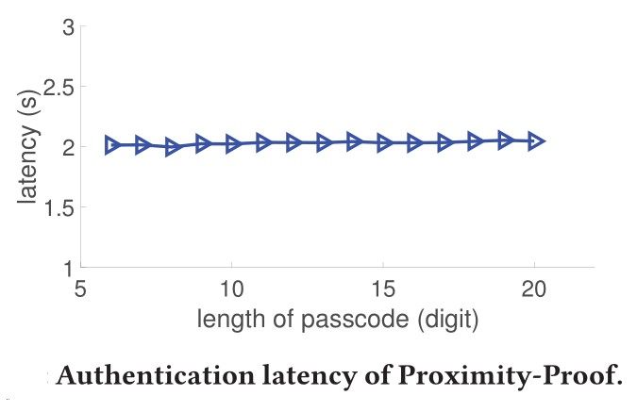
Authentication Latency
Duo Mobile Authentication | Latency
Phone-call | 30s
Push | 7.4s
SMS | 10.6s

Slide 31
Usability Study
22 volunteers use both Duo and Proximity-Proof
Q1. whether Proximity-Proof is easy to use
Q2. whether Proximity-proof is faster than Duo
Q3. whether the passcode and phone call options of Duo are bothering
Q4. whether they heard any obtrusive noise during Proximity-Proof’s authentication procedure
Q5. their preference between Duo and Proximity-Proof

Slide 32
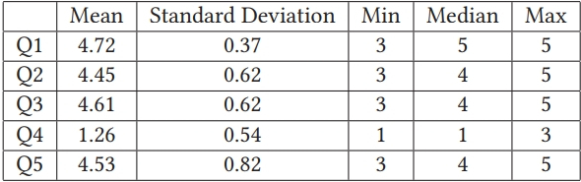
Usability Study
Scores ranged from 1(lowest) to 5 (highest)

Slide 33
Proximity-Proof Flaws
Requires login device to have a connected microphone
Requires login client to support Proximity-Proof operation
The paper assumes there is a direct line-of-sight channel between the 2FA device and and the client
If the phone not being in direct line of sight (e.g. in a pocket, bag, etc.) will prevent the 2FA from working properly, then it will fail
Tradeoff between thwarting co-located attack and allowing legitimate logins

Slide 34
Out of Scope
Attacks
Compromised, lost, or stolen 2FA devices
DoS attacks in which attacker only wants to cause endless communication between enrolled 2FA device and server, not to login
Acoustic jamming attacks to prevent legitimate logins
Devices
Hardware tokens
Non-smartphones, including landline phones

Slide 35
Thank you & Questions?

